Slide 1


CASE STUDY ON RAZORPAY
GROUP 5
ROLL NUMBER | NAME
13000121050 | ARIF ALI
13000121040 | SAGNIK MUKHOPADHYAY
13000121033 | SOUMYADEEP NANDY
13000121037 | PRITHWISH SARKAR
13000121058 | ARKAPRATIM GHOSH
CA 1 : PROJECT MANAGEMENT AND ENTREPRENEURSHIP (HSMC701)
CSE : SEMESTER 7

Slide 2

CONTENT
OVERVIEW
CHALLENGES FACED
VENTURE LIFE CYCLE
SOLUTIONS IMPLEMENTED
SALES AND MARKETING ANALYSIS
CONCLUSION
REFERENCES

Slide 3
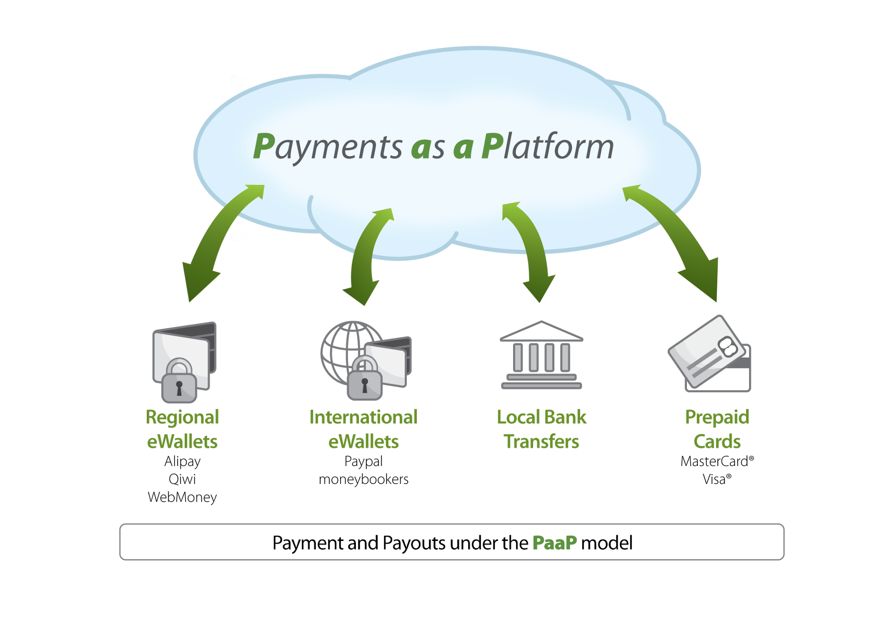
OVERVIEW
Razorpay is a leading financial technology company based in India that offers a comprehensive suite of payment solutions for businesses of all sizes.
It is a ten-year-old Indian B2B fintech startup in digital payments which is venturing into digital lending.

Slide 4
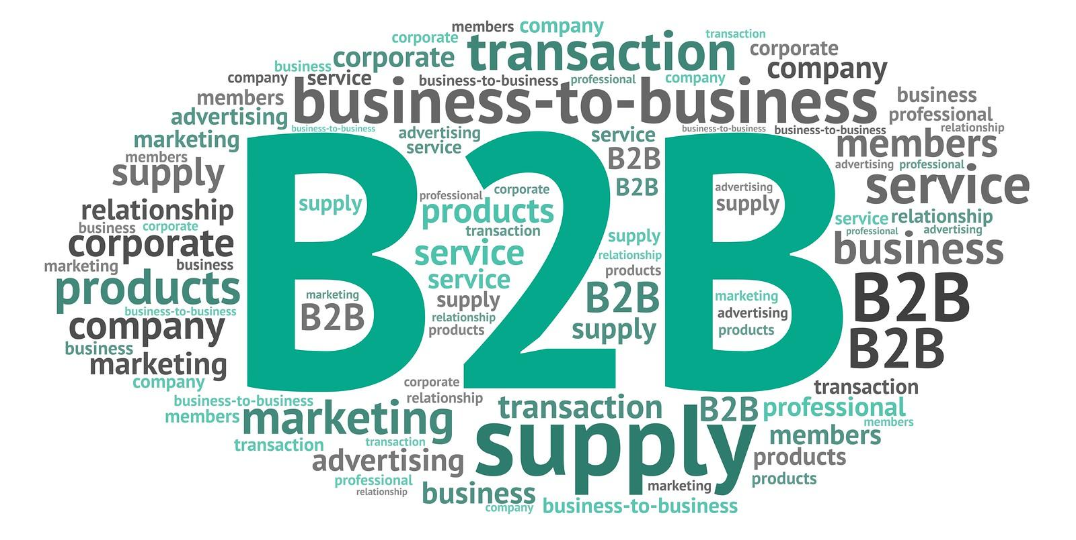
OVERVIEW (CONTINUED)
Razorpay a B2B payment solutions provider
It aims to simplify digital payment flows involved in acceptance, processing and disbursement of payments through superior technology and automation.

Slide 5
OVERVIEW (CONTINUED)
Founded in 2014 by Harshil Mathur and Shashank Kumar, Razorpay aims to simplify and enhance the digital payment experience by providing a seamless and secure platform for online transactions.
It offers a wide range of payment solutions under one roof, reducing the need for multiple service providers.
To maintain its growth trajectory, Razorpay has launched multiple new products in the digital payment space as well as announced a foray into creating a marketplace for digital lending through launch of Razorpay Capital.
This overview examines the critical challenges faced by Razorpay, the evolution of its venture lifecycle, the innovative solutions it implemented, and an analysis of its sales and marketing strategies that contributed to its success.

Slide 6
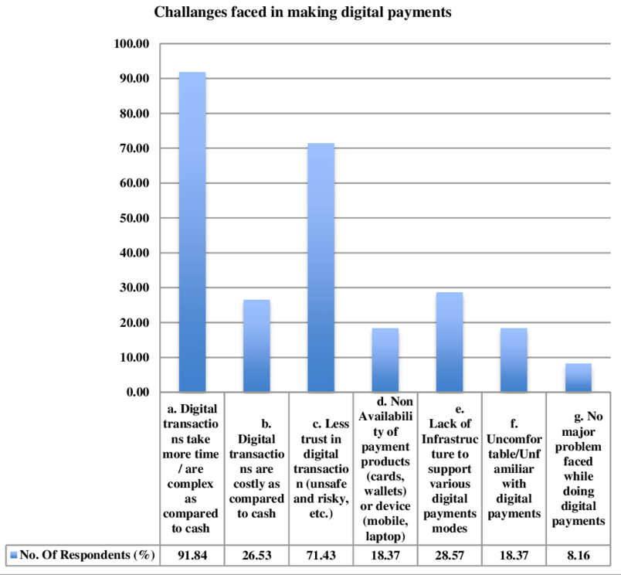
CHALLENGES FACED
Market Penetration
Educating Businesses on Digital Payments
Raising awareness about the benefits of digital payments.
Conducting workshops and training sessions for SMEs.
Providing resources and support to onboard businesses.
Building a Secure and Reliable Platform
Developing a robust and scalable infrastructure.
Ensuring uptime and reliability amidst high transaction volumes.
Implementing strong encryption and security measures.
Scaling Operations Amid Rapid Growth
Managing rapid customer acquisition and onboarding.
Expanding the team and operational capabilities.

Slide 7
CHALLENGES FACED (CONTINUED)
Initial Challenges
Gaining Trust in a Traditional Market
Overcoming skepticism towards online payments among businesses and consumers.
Building credibility in a market dominated by cash transactions.
Ensuring data security to gain user confidence.
Competition from Established Players
Competing with well-established companies like Paytm, CCAvenue, and PayPal.
Differentiating Razorpay offerings from competitors.
Securing market share in a crowded space.
Regulatory and Compliance Hurdles
Navigating complex financial regulations in India.
Ensuring compliance with RBI guidelines and KYC requirements.
Adapting to frequent regulatory changes.

Slide 8
CHALLENGES FACED (CONTINUED)
Technology and Infrastructure
Ensuring Platform Security and Fraud Prevention
Implementing advanced fraud detection algorithms.
Continuously monitoring for suspicious activities.
Investing in cybersecurity measures and infrastructure.
Managing High Transaction Volumes
Optimizing the platform for peak traffic and transaction loads.
Ensuring seamless payment processing even during high demand periods.
Balancing speed and accuracy in transaction processing.
Integrating with Various Banks and Financial Institutions
Establishing and maintaining relationships with multiple banking partners.
Ensuring smooth and secure API integrations.
Handling discrepancies and ensuring reconciliation across platforms.

Slide 9

VENTURE LIFE CYCLE
The venture lifecycle is a series of stages that a business goes through from ideation to exit, including conception, seed funding, startup, growth, expansion, maturity, and exit, each with unique challenges and opportunities.

Slide 10
VENTURE LIFE CYCLE (CONTINUED)
Ideation/Conception (2013):
Founders Harshil Mathur and Shashank Kumar identified the problem of cumbersome payment processes for Indian businesses.
Seed Stage (2014):
Development of the business plan and MVP.
Secured seed funding from angel investors and incubators like Y Combinator.
Startup Stage (2014-2015):
Officially launched Razorpay.
Began onboarding initial customers and processing transactions.
Raised Series A funding from investors like Tiger Global and Matrix Partners.
Growth Stage (2016-2018):
Expanded product offerings to include more payment solutions.
Significant increase in customer base and transaction volumes.
Secured Series B and C funding rounds to support scaling efforts.

Slide 11
VENTURE LIFE CYCLE (CONTINUED)
Expansion Stage (2019-2020):
Diversified services to include lending (Razorpay Capital) and neobanking (RazorpayX).
Formed strategic partnerships and entered new markets within India.
Raised Series D and E funding to fuel further expansion.
Maturity Stage (2021-present):
Established itself as a market leader in the Indian fintech space.
Continued innovation and introduction of new financial products.
Raised Series F and G funding, achieving a valuation of over $7 billion, signaling strong market presence and stability.
Future Exit Stage (potential):
Possibilities include an IPO or acquisition by a larger financial entity.
Ongoing focus on maintaining growth and profitability to maximize exit options.

Slide 12

SOLUTIONS IMPLEMENTED
RazorPay is a comprehensive financial technology company providing a suite of payment solutions to businesses.
Focuses on simplifying and automating payment processes, enhancing business efficiency and customer experience.
Key Solutions:
Payment GatewaY
RazorPayX
Payment Links
Subscriptions
Smart Collect

Slide 13
SOLUTIONS IMPLEMENTED (CONTINUED)
Payment Gateway:
Features:
•Supports multiple payment methods: Credit/Debit Cards, UPI, Net Banking, Wallets.
•Real-time tracking, fraud prevention, and analytics.
Benefits:
•Streamlines checkout experience, reducing cart abandonment.
•Enhances trust with secure transactions.
RazorPayX:
Features:
•Automated payouts: Schedule and automate bulk disbursals.
•Smart corporate card: Manage and control business expenses.
•Current accounts: Integrated with powerful APIs for seamless operations.
Benefits:
•Saves time with efficient payout automation.
•Enhances cash flow management and financial transparency.

Slide 14
SOLUTIONS IMPLEMENTED (CONTINUED)
Payment Links:
Features:
•Easily create and share payment links via SMS, email, WhatsApp.
•Customizable: Add descriptions, set amounts, and expiration dates.
•Real-time tracking of payment status and updates.
Benefits:
•Simplifies payment collection for one-time transactions.
•Provides flexibility and convenience to customers.
•Facilitates quick and secure payment without the
need for a website.
Subscription Management:
Features:
•Automated recurring billing for subscriptions.
•Supports multiple subscription plans: weekly, monthly, yearly.
Benefits:
•Ensures timely payments with automated billing.
•Simplifies management of subscription plans and renewals.

Slide 15
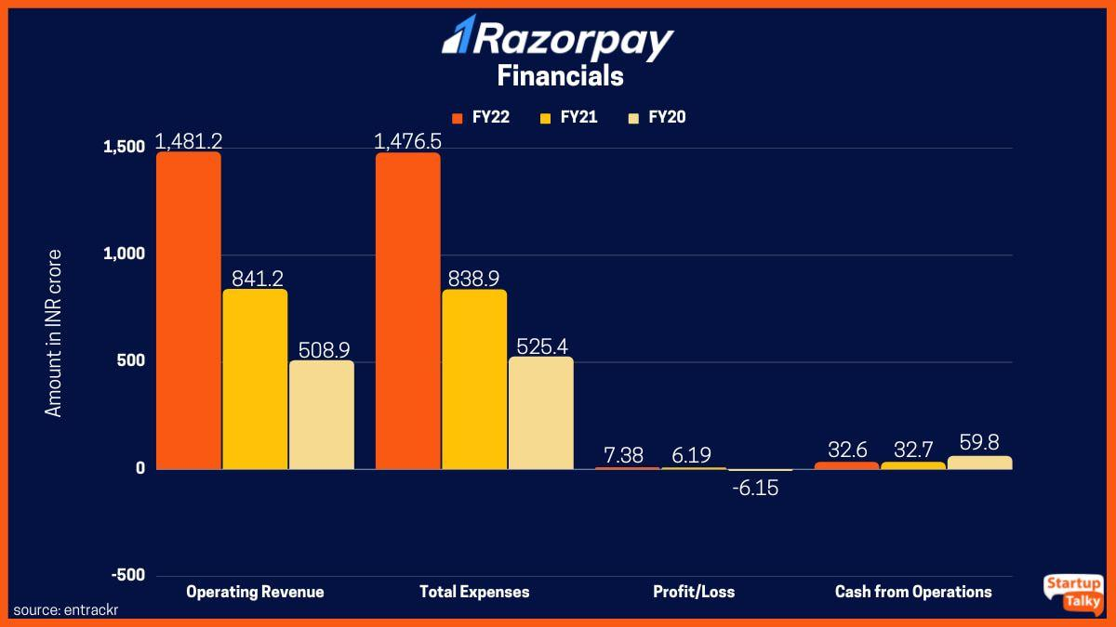
SALES AND MARKETING ANALYSIS
Market Trends & Online Marketing
Massive Shift to Online Marketing: Over 50% of marketers are expected to allocate more resources to online mediums.
Importance of Market Analysis: Businesses need to conduct market analyses and understand industry trends.
Solution-Oriented Content: Acts as a strong lead generator for businesses.
Reliance on Lead Generation: Most SaaS and service-based companies depend on lead generation for revenue and sales.

Slide 16

SALES AND MARKETING ANALYSIS (CONTINUED)
Marketing Strategies
Social Media Marketing: Brands can build a strong audience base and drive engagement by posting shareable content.
Internet Marketing: Uses all web-based channels for spreading messages about products and services.
Conversational Marketing: Involves real-time interaction with the brand through chatbots or customer service executives.
Benefits of Conversational Marketing: Provides a sense of security to customers and is effective for tech-based and e-commerce companies.

Slide 17

SALES AND MARKETING ANALYSIS (CONTINUED)
Marketing Mix Strategy
Product Strategy: Includes products like Razorpay Route, Smart Collect, Subscriptions, and Invoices, along with Razorpay Capital and RazorpayX.
Pricing Strategy: Offers Standard and Enterprise plans, with customized options for large transaction volumes.
Place Strategy: Provides various online payment modes and a comprehensive dashboard for handling payments.
Promotion & Branding: Focuses on sectors like e-commerce, ed-tech, and small enterprises, and offers collateral-free credit lines for MSMEs.

Slide 18
CONCLUSION
REFERENCES
Razorpay is a leading payment gateway in India, offering seamless integration and a comprehensive range of payment methods, including cards, UPI, and net banking. It stands out with advanced features like automated payouts and subscription management, making it an ideal choice for businesses of all sizes seeking a reliable and versatile payment solution.
https://infovistar.in/razorpay-case-study-revolutionizing-online-payments-in-india/
https://research.contrary.com/company/razorpay
https://drive.google.com/drive/u/2/folders/1YX41Cb4TRn1dcsuf29Qx1z1fZUIA15Dt
THANK YOU

